Slide 1
Internet Of Things Workshop
Sit with a partner :)

Slide 2
Please sign in!
hkn.mu/sign_in

Slide 3
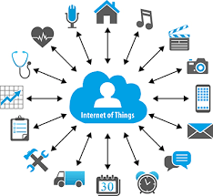
What is IOT
Advances in Communication Technology allow new devices to connect to the internet
Acquire data and share it with a server
More data allows for new applications and “smart” systems
Machine-to-Machine communication

Slide 4
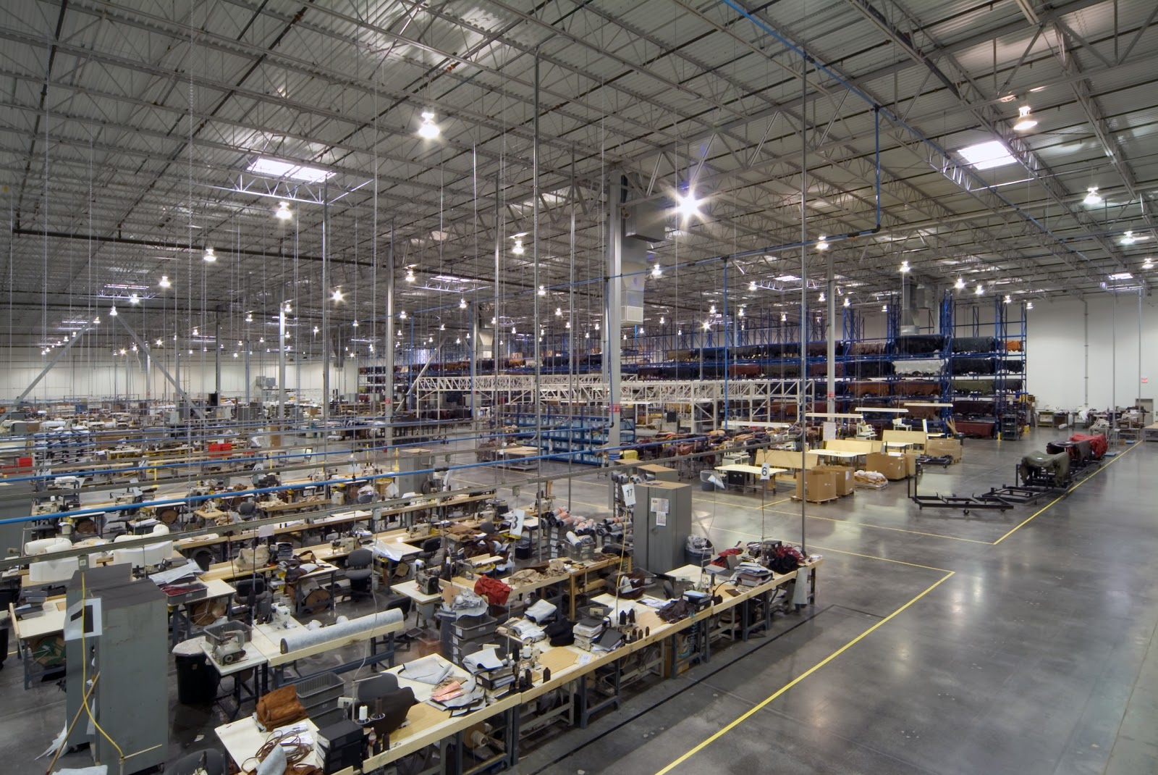
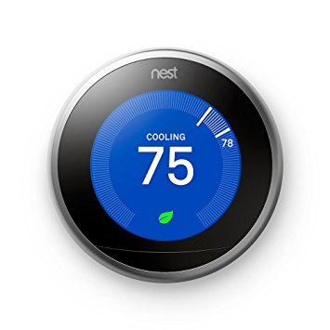

IOT can be useful!
Factories can use to better organize production
UPS uses it currently to monitor its vehicles and improve route planning
NEST thermostats improve HVAC efficiency using collected data

Slide 5
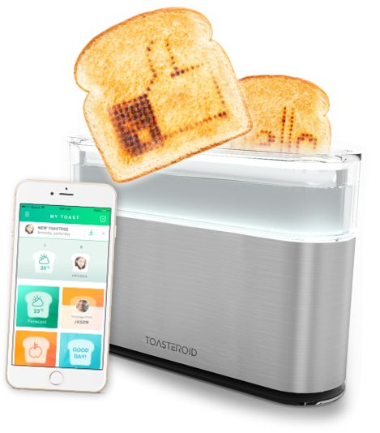
IOT can be useless as well...
Just connecting things to the internet doesn’t make them useful
Examples:
Internet connected toaster
Smart tape measure
Smart Frying Pan

Slide 6
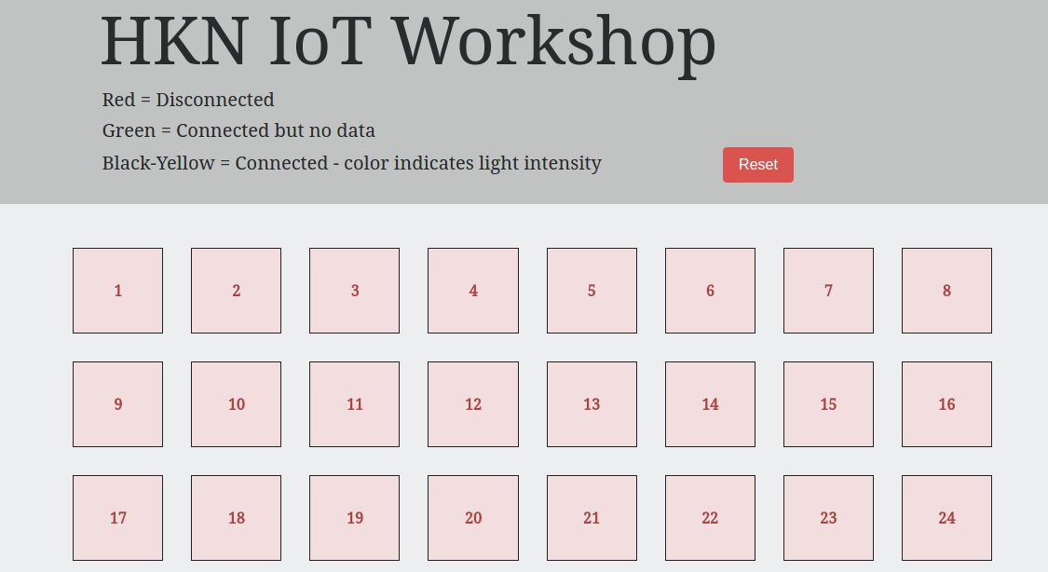
What are we going to do?
We will build a distributed light map
Each of you will connect an MSP to a light sensor
The MSP will relay data to the PC
The PC will relay data to our server
The server will post updates to the website

Slide 7
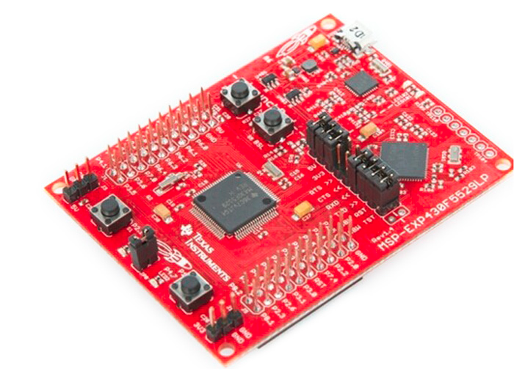
Phase 1: Setting up the MSP
We are using MSP430 microcontrollers
The microcontrollers will read data from the ADC
The microcontrollers will output data over UART to the PC

Slide 8
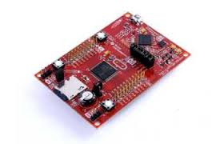
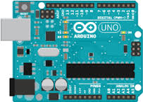
What is a microcontroller?
Microcontrollers are small processing units
Include all necessary peripherals
Memory
Clock
Timers
Analog to Digital Converters
Allow for an easy interface between software and hardware

Slide 9
IOT Sensor Nodes
We are using the MSP as the a sensor Node
In IOT systems, Sensor Nodes are used to collect data across a system
Usually these nodes have low computing power
Only use is data collection and relaying
Usually connected to the internet

Slide 10
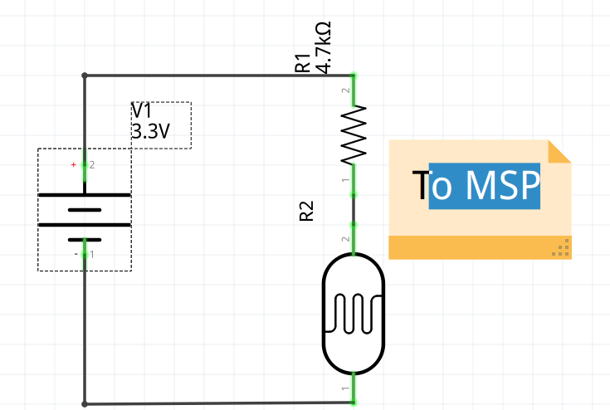
Our Sensor:

Slide 11
A Quick Intro To Circuits
A circuit is one or more closed loops for current flow through
Current is like water flowing through pipes
Voltage is like height, it creates a force to push current through a circuit

Slide 12
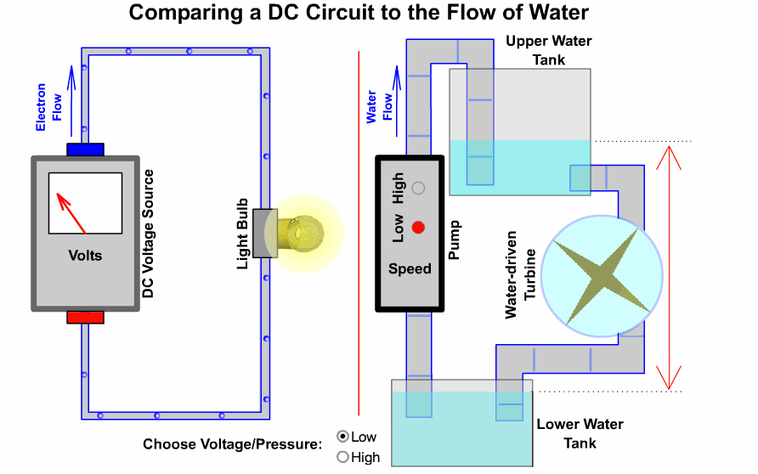
A Quick Intro To Circuits

Slide 13
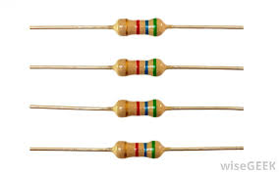

Resistors
Resist the flow of current, create a voltage drop.
We use them to control how much current is in an element

Slide 14
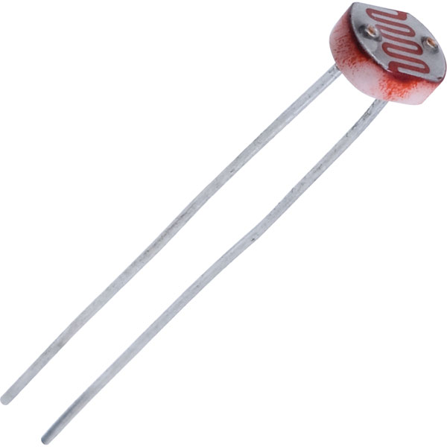
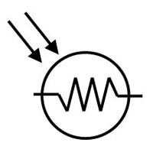
Photoresistors
Photoresistors change their resistance based on how much light is on them

Slide 15
How do we read this change in resistance?
MSP’s can only read a change in voltage, however a photoresistor changes its resistance when there is light across it.
The circuit to the right allows us to do so
The output voltage is set by the ratio of the two resistors. As one resistor changes, the other stays constant (since it’s not photosensitive) this changes the output voltage

Slide 16

Where do we build this circuit?
Breadboards!
The allow us to connect different circuit elements together. Each column is internally connected, but there’s a break in the middle

Slide 17
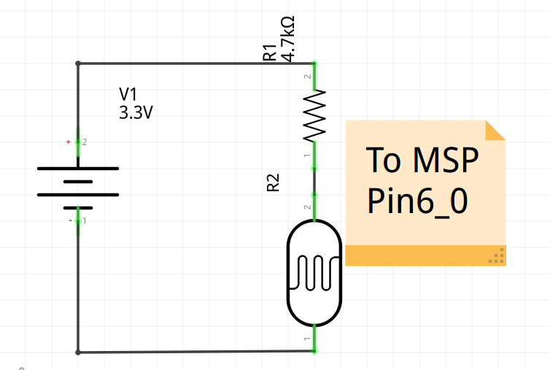
Build The Circuit!
The 3.3V battery comes from the MSP, there’s a pin labeled 3.3v
We will provide the photoresistor and the resistor
You can find wire’s at the central station, strip them and connect them to the breadboard

Slide 18

The MSP Code
On the computers start the software called energia
Go to hkn.mu/msp_code
The code needs to be filled in
Comments (stuff inside a /* or //) explain what the code needs to do
Make sure the set the correct port (Tools->Port)
Once you are done, upload the code, and start the serial monitor using CTRL+SHIFT+M
Ask us for help!

Slide 19
Phase 2: Setting up the PC
We have a Sensor node acquiring data
We need to send this data to our server using the PC
We’ve already created a server for you and deployed on Heroku
The website for the server is:
http://hkn-iot-workshop.herokuapp.com/

Slide 20
Web Communication
The server is listening on an IP address for data coming in
The PC sends data using Websockets to the server
What are websockets?
Websockets are a communication protocol
Allows for communication to between a client and a server
Common, not very secure

Slide 21
A note on Security
A server that interacts with the global Internet needs to be secure! Anyone in the world can hack into and take over our server if we aren’t careful.
IoT hardware also needs to be secure! Hackers can attack the smallest of devices (microcontrollers, webcams, even your smart toaster…)
Your computer’s webcam, or your toaster, might be recruited into a Botnet for DDoS (Distributed Denial of Service) attacks :(
Notable attacks: October 21, 2016 DDoS attack caused US internet outages

Slide 22
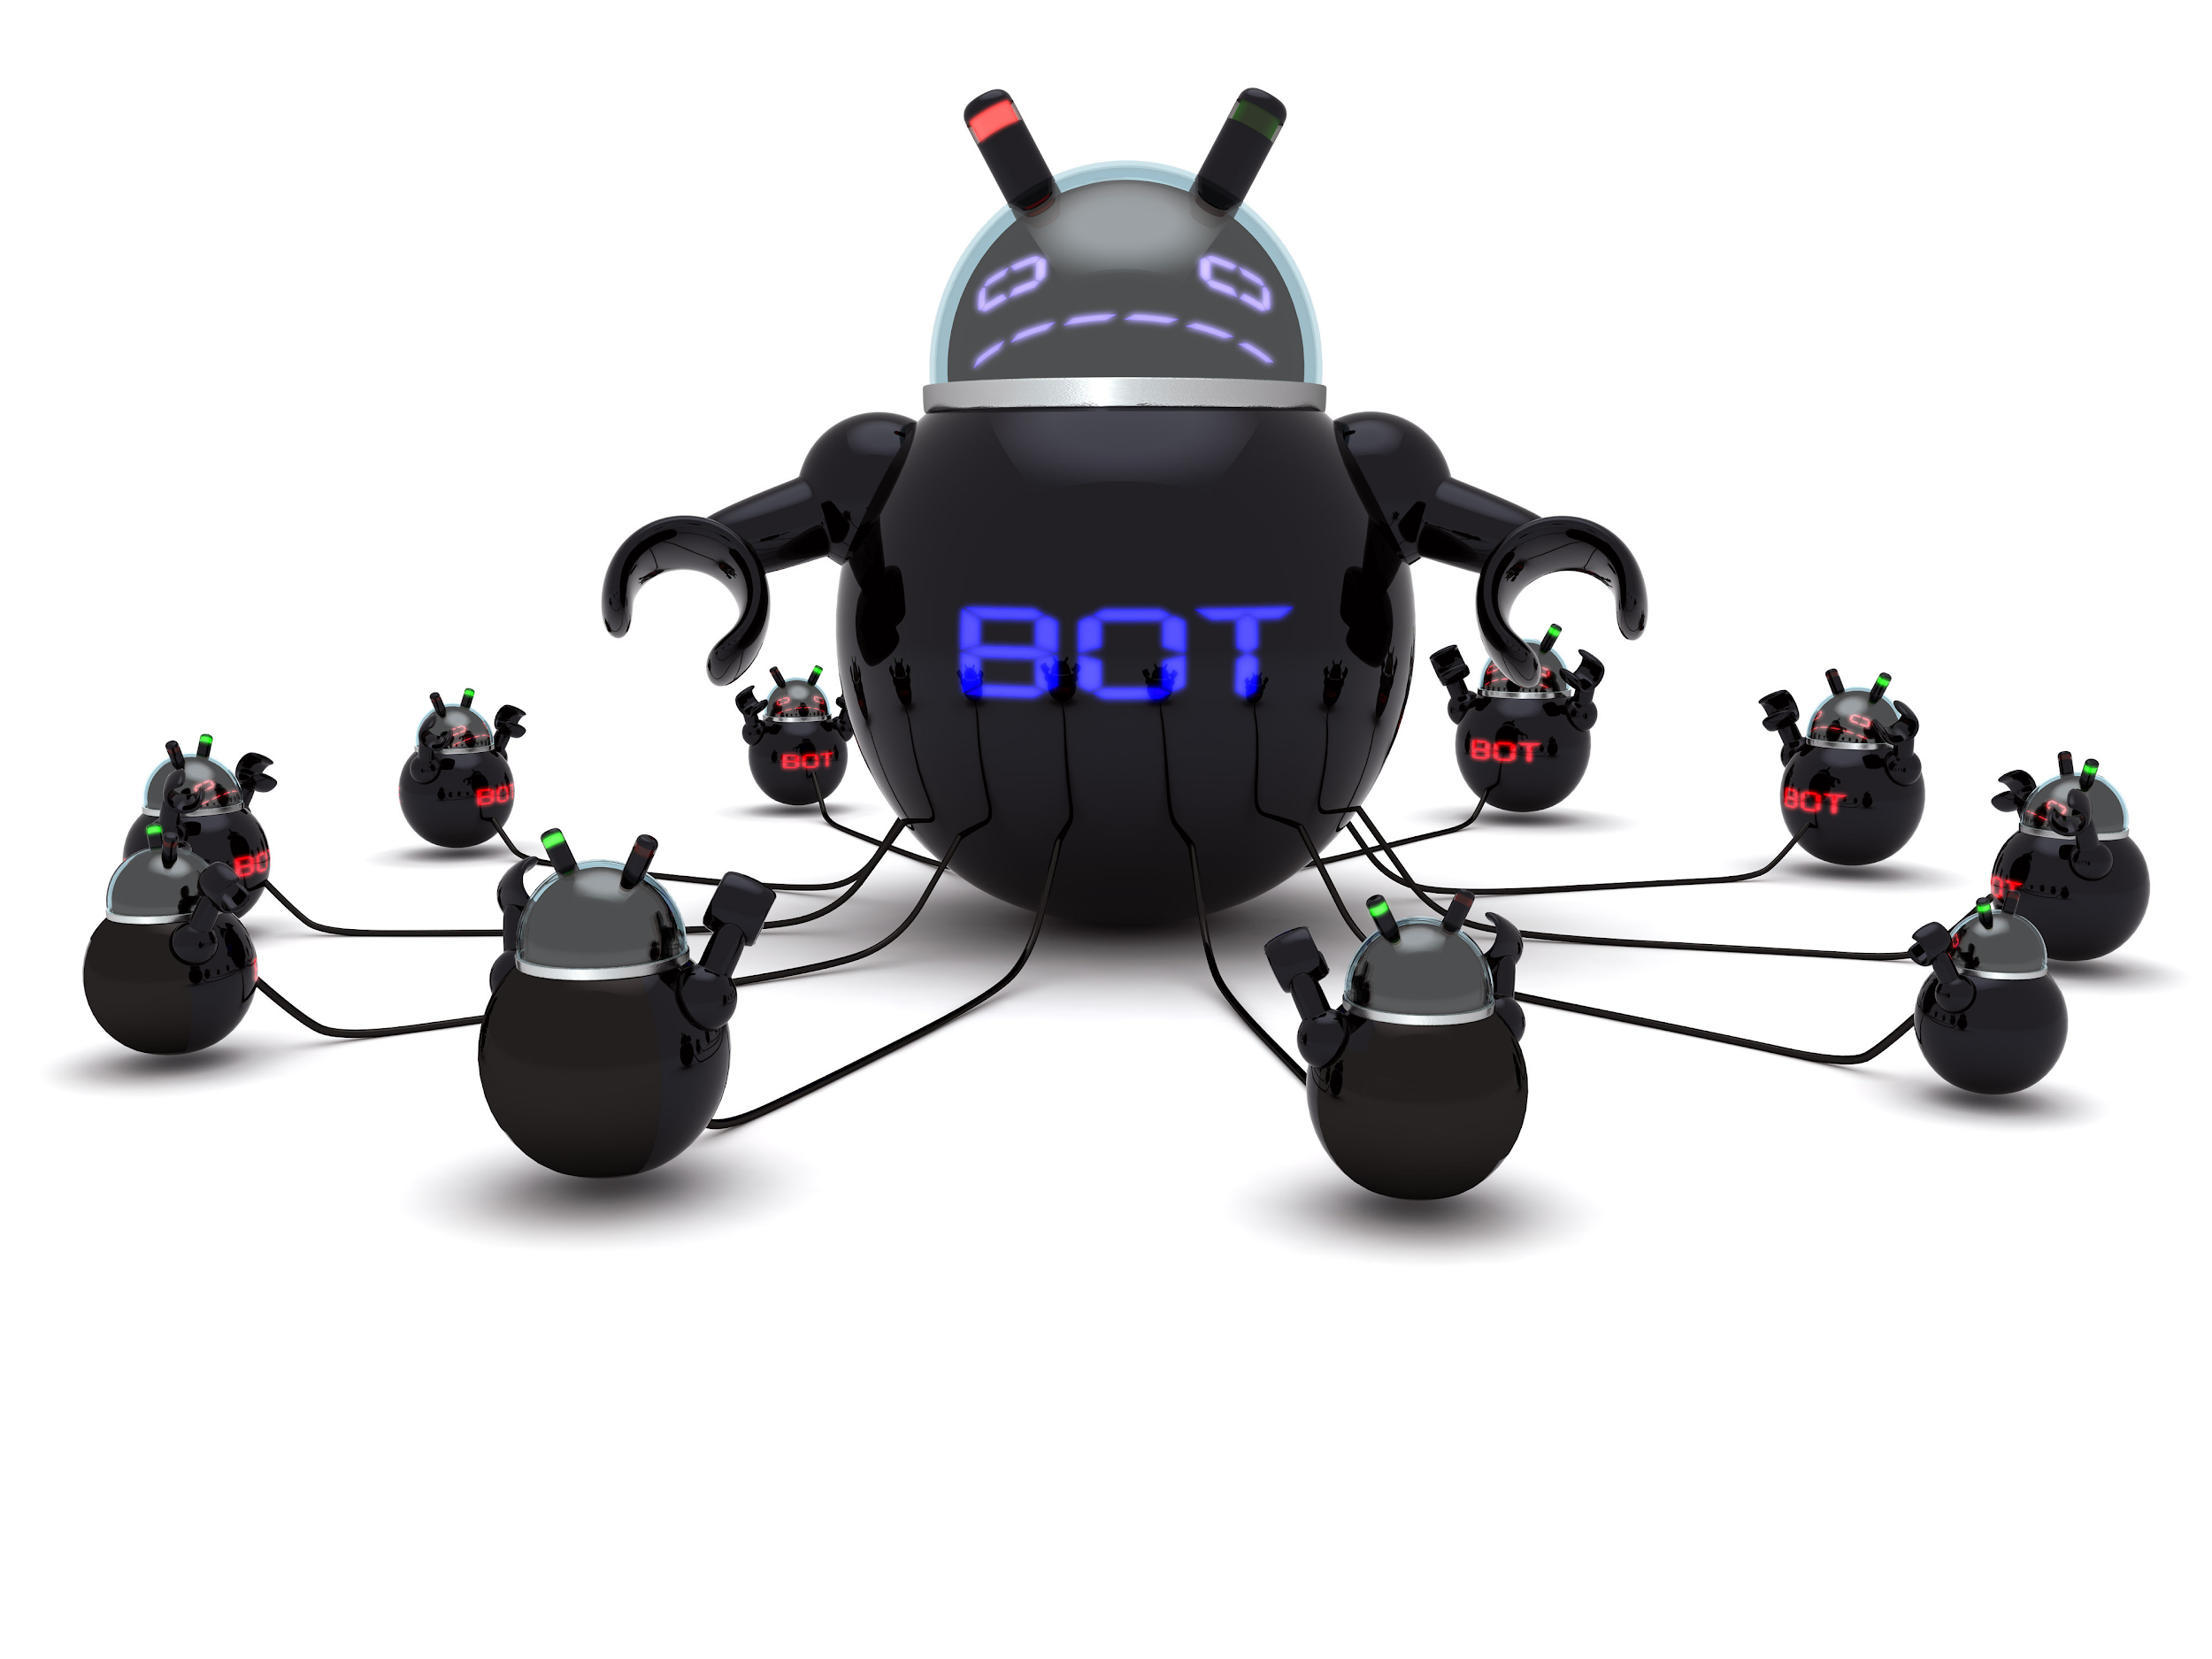
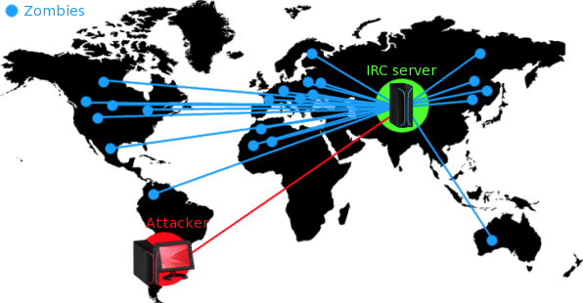
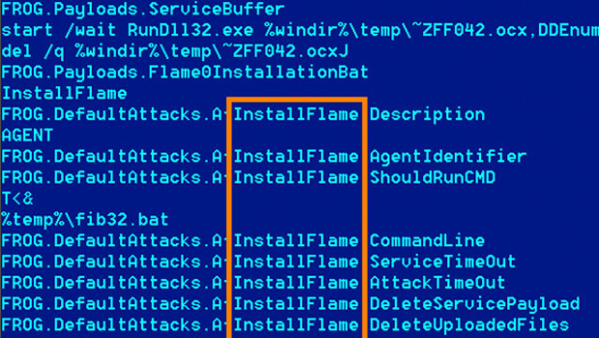
Some spooky stuff...

Slide 23
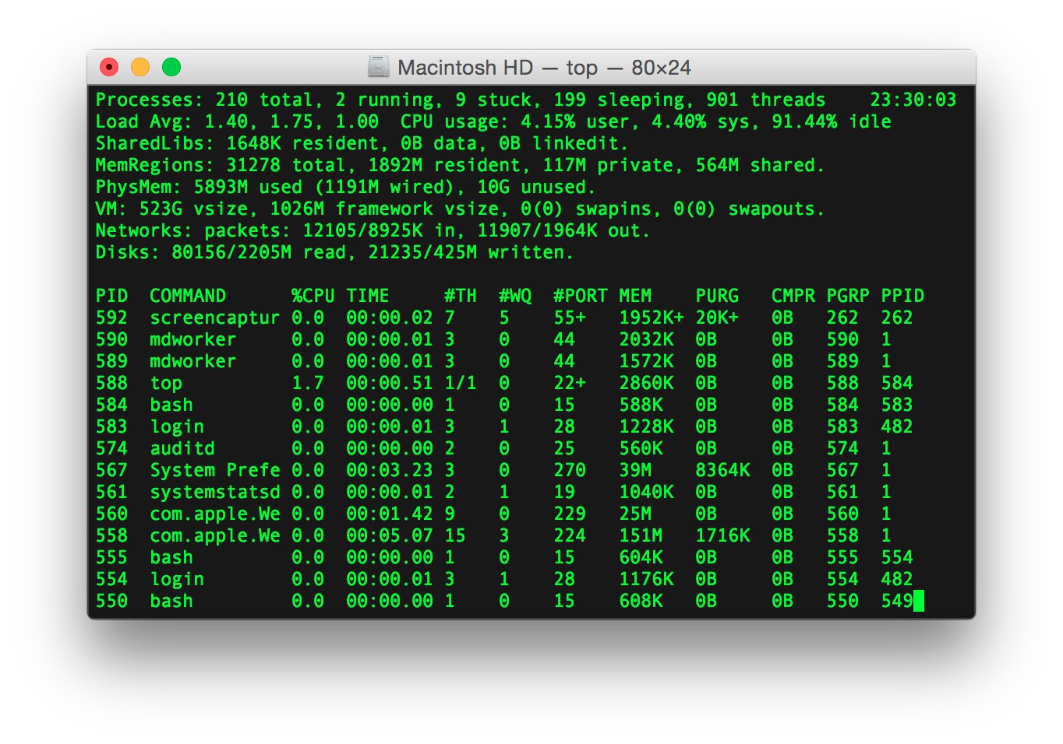
Using Terminal
We will be writing Python Code to read data from the MSP and output it to the server.
Python code must be run from the terminal

Slide 24
Installing some software
In order to run this code, you need to install some software onto the computers.
Search your computer for the Anaconda Terminal
Start the Anaconda Terminal: type: pip install SocketIO_client
Let us know if there are any issues!

Slide 25
Navigating through terminal
dir : List all the files in the current directory
cd : Change directory to a different directory
python filename --args

Slide 26
Writing the PC Code
Download the code at hkn.mu/client_code
Fill in the code and run it go to : http://hkn-iot-workshop.herokuapp.com/
Debugging Help:
Use sublime text to edit the code. Search for sublime on the computer
You must turn off the Serial Monitor in Energia for the code to work

Slide 27
Extra modifications and Fun
Try to change the MSP code so the light sensor is more sensitive to changes
Try to connect more than one MSP to the same computer
Try to add another light sensor and take the average of the two readings on your sensor node

Slide 29
hkn.mu/iot_feedback

